Slide 1
Defining Equity and Excellence in Education
Presenter: Jennifer Godinez, Associate Executive Director

Slide 2
MMEP’s Vision
We envision a just society in which an equitable educational ecosystem ensures all students achieve their full potential. Achieving this vision would mean that race is no longer a predictor of educational success.

Slide 3
MMEP’s Mission
Minnesota Minority Education Partnership uses a race equity lens to transform educational institutions, organizations, and leaders to ensure that students of color and American Indian students achieve full academic and leadership success.
Minnesota Education Equity Partnership:
Advancing Race Equity and Excellence

Slide 4
We have all seen disparities in education in MN along the continuum (PreK to 20).
We describe them as the “achievement gap”
Race Equity is not the Achievement Gap.

Slide 5
Source: SLEDS, Minnesota Office of Higher Ed

Slide 6
Source: SLEDS, Minnesota Office of Higher Ed

Slide 7
Toward Excellence with Equity: An Emerging Vision for Closing the Achievement Gap, Dr. Ron Ferguson

Slide 8
Source: SLEDS, Minnesota Office of Higher Ed

Slide 9
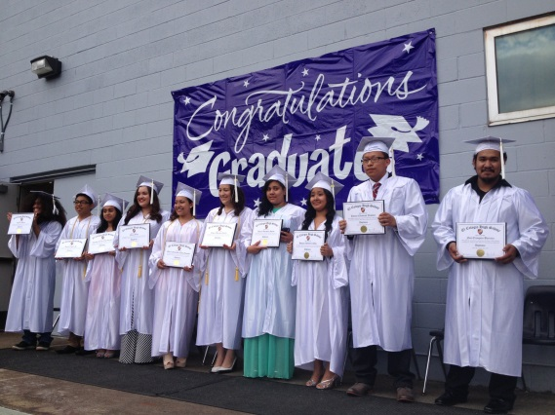
Defining “equity in higher education?” The phrase “equity in higher education” refers to creating opportunities for equal access and success in higher education among historically underrepresented student populations, such as ethnic minority and low-income students. Within the postsecondary education community, “equity” is further defined into three terms including:
representational equity, which refers to the proportional participation of historically underrepresented student populations at all levels of an institution;
resource equity, which takes account of the educational resources, when unequally distributed, that are directed at closing equity gaps; and
equity mindedness, which involves institutional leaders and staff demonstrating an awareness and a willingness to address equity issues.
-By Dr. Estela Mara Bensimon, Center for Urban Education, Rossier School of Education at the University of Southern California

Slide 10
Policy changes that could be adopted to help address equity issues in higher education:
Some policy recommendations include:
establishing accountability practices for routine data collection, use, and
reporting to continually monitor the status of educational opportunity and
outcomes by racial-ethnic student groups and
(2) allocating resources to develop systemic and institutional capacity to transform accountability from a system of data reporting into a system for organizational learning and successful change.
-By Dr. Estela Mara Bensimon, Center for Urban Education, Rossier School of Education at the University of Southern California

Slide 11
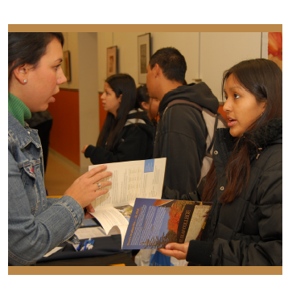
“It is not just the absence of discrimination and inequities, but also the PRESENCE of deliberate systems and supports to achieve and sustain racial equity.”
Race Equity and Inclusion Action Guide. 7 Steps to Advance and Embed Race Equity and Inclusion within Your Organization.—Annie E. Casey Foundation

